Slide 1

HTTP Basics
HTTP Request & HTTP Response
SoftUni Team
Technical Trainers
Software University
https://softuni.bg

Slide 2

Table of Contents
The HTTP Protocol – Basic Concepts
HTTP Developer Tools
HTML Forms
HTTP Request
HTTP Response
URLs and URL Structure

Slide 3
Have a Question?
sli.do
#fund-common

Slide 4
HTTP Protocol – Basics
http://

Slide 5


HTTP Basics
HTTP (HyperText Transfer Protocol)
Text-based client-server protocol for the Internet
For transferring Web resources (HTML files, images, styles, etc.)
Request-response based, relies on URLs (like https://softuni.org)
Stateless
HTTP request
HTTP response
Web Client
Web Server
Notes:
The HTTP protocol is stateless by design, which means that it does not preserve state.
Each HTTP request is independent of the others.
Stateful HTTP conversations can be implemented by extra effort, using cookies, custom header fields, Web storage or other techniques.

Slide 6
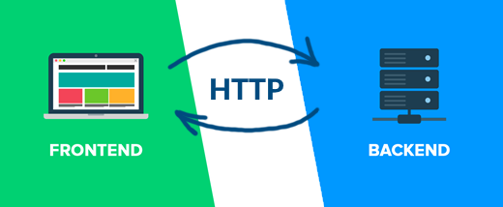
Front-End and Back-End
Front-end and back-end separates the modern apps into client-side (UI) and server-side (data) components
Front-end == client-side components (presentation layer), e.g. React app
Implement the user interface (UI)
Back-end == server-side components (business logic APIs), e.g. ASP.NET Core
Provide data storage and processing
HTTP connects front-end with back-end

Slide 7






The Client-Server Model in Web Apps
Web Client
Web Server
Backend
Request
Response
Web Resources
Database
HTML, PDF, JPG…

Slide 8
Network Layers and HTTP
HTTP request
HTTP response
URL
HTTP
HTTP
TCP
TCP
IP
IP
Ethernet
Media (wires / air / fiber)
Ethernet
Notes:
The HTTP request consists of request line + headers + body, which travel to the Web server via lower-level protocols.
The data sent over a HTTP connection travels to the Web server via a TCP stream. TCP is a transport layer protocol, that connects two endpoints through a reliable, bi-directional, stream-oriented connection.
It is important to mention that TCP uses port numbers to allow multiple parallel connections between two endpoints.
Usually the Web server uses port 80 for plain HTTP and port 443 for HTTPS (which stands for HTTP over TLS – the transport layer security extension).
The Web client uses a random unallocated source port number (for example 61850).
The TCP protocol sends the stream data broken down into IP packets over the Internet using the IP protocol (the Internet Protocol).
The IP protocol transfers data packets between two IP addresses in Internet.
IP packets travel from the sender to the local network gateway, then to some Internet router, then to the next router, and to the next router, etc., until they reach their target network and their final IP address.
When the data packets reach the destination data center, they travel between the network devices around the data center over Ethernet, PPP or other local area network protocol, until they reach the machine, operating the destination Web server.
These data packets (which are called "Ethernet frames") in the Ethernet local network are transferred between two MAC addresses (or two network adapters), over LAN cables.
Networking devices (such as switches, routers, hubs, repeaters, modems and bridges) communicate with each other through physical transmission media, such as LAN cables, fiber-optic cables, and electromagnetic waves in the air.
Data travels between two endpoints in both directions using all these layers of networking protocols, but this complexity is hidden for the Web developers, which use only the HTTP protocol through client-side and server-side APIs.
Finally, when the HTTP request is received by the Web server, it replies with an HTTP response and the response travels back to the Web client using all mentioned network layers and protocols.
To use HTTP we need a URL (a unique resource address on the Web), which identifies :
the Web server IP or server name (which is resolved to IP address);
the port number (when we use different than the default ports 80 or 443);
and the path to the resource on the Web server.
We shall talk about URLs in detail a bit later.

Slide 9

HTTP Dev Tools

Slide 10
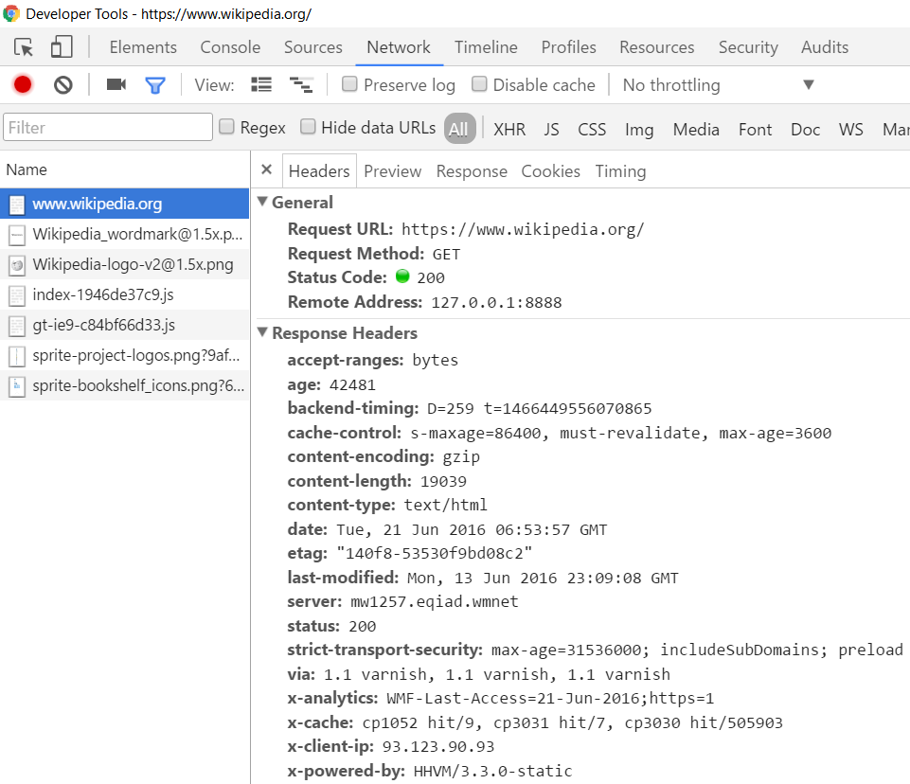
HTTP Developer Tools: Network Inspector
Chrome Developer Tools
Press [F12] in Chrome
Open the [Network] tab
Inspect the HTTP traffic
Notes:
You will see the Chrome Dev Tools window, which has many tabs.
From the [Elements] tab you can inspect the UI controls on the Web page (the so-called DOM tree).
From the [Console] tab you can see the errors and logs for the currently loaded Web page, and you can execute JavaScript commands.
From the [Network] tab you can view and inspect the HTTP traffic between the currently open Web page and the Web servers to which the page communicates.
We can click on certain request to view the details about it:
The HTTP request URL
The request method
The remote server IP address and port
The request headers (such as the "Host" header, for example)
The request body (which is empty for GET requests)
The response status code (200 OK)
The response headers (such as the "Content-Type" header)
The response body (which holds the requested resource, in our case an HTML document)

Slide 11
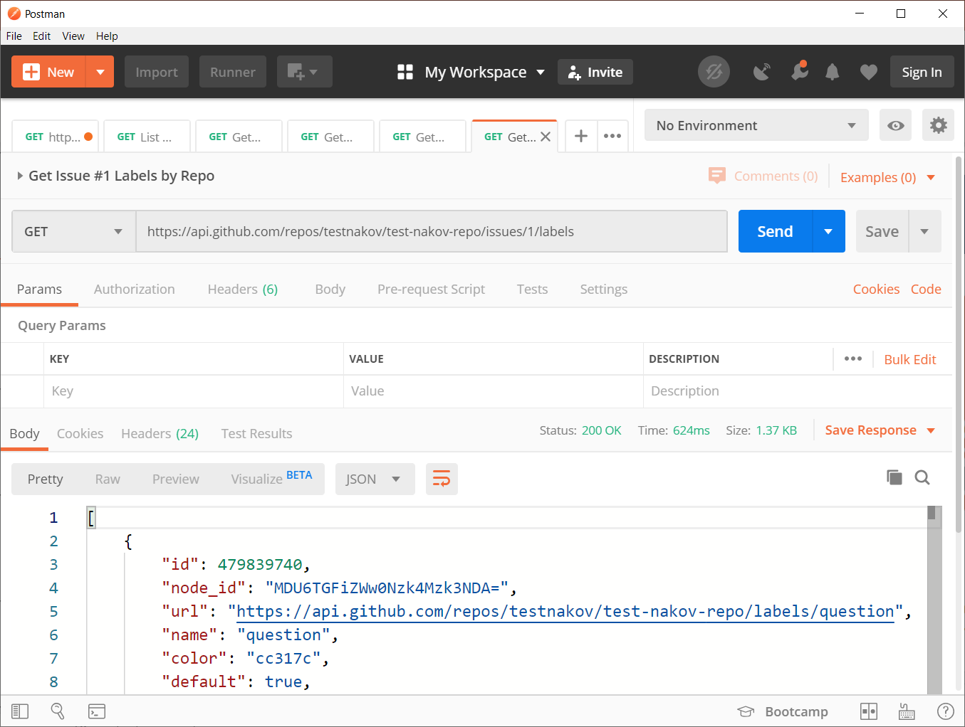

HTTP Developer Tools: HTTP Client Tools
Postman
HTTP client tool for developers
Compose and send HTTP requests
Insomnia Core
Postwoman
Notes:
Postman is a HTTP client tool for developers. With Postman you can create an HTTP request, send it to the Web server, view the HTTP response, and generate a source code to execute the HTTP request in many languages, such as JavaScript, C#, Java, Python, PHP and many others.
Now, lets see an example with Postman. We can send an HTTP request to retrieve the issue #1 from the "aspnetcore" project at GitHub, using the GitHub API, which is accessible via the HTTP protocol.
We create a new request and name it "Get GitHub issue". An we save the request in Postman.
And we choose HTTP method GET for this request.
We enter the following URL for the HTTP request: https://api.github.com/repos/dotnet/aspnetcore/issues/1.
And we click the [Send] button.
The Web server at api.github.com responds with a long JSON object, holding a detailed information about the requested issue.
We can view a code example for sending this HTTP request in JavaScript, C#, Java or other programming language.
We open the [Generate Code Snippets] dialog window by clicking on the [Code] button.
We select [HTTP] to see the HTTP request.
We can select [JavaScript - Fetch] to see how to invoke this request from a client-side JS application, running in the Web browser.
We can select also [Java] to see a sample Java code for invoking the same request from Java.

Slide 12

HTML Forms
Form Submission: GET and POST

Slide 13
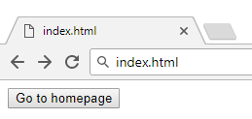
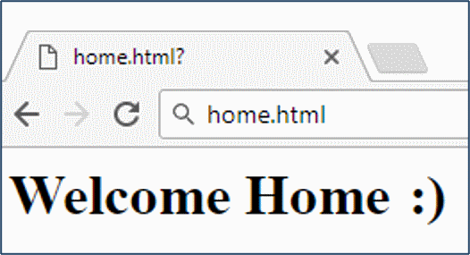
HTML Forms: Action
The "action" attribute defines where to submit the form data
Relative or full URL
<form action="home.html">
<input type="submit" value="Go to homepage"/>
</form>
Example: https://repl.it/@nakov/http-form-example

Slide 14
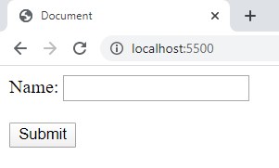
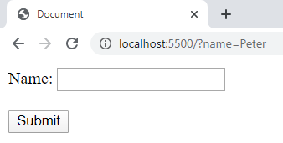
HTML Forms: Method GET
Forms can specify the HTTP method for sending the form data
<form method="get"> Name: <input type="text" name="name"> <br /><br />
<input type="submit" value="Submit">
</form>
The form data is in the URL
Peter
Example: https://repl.it/@nakov/http-get-example

Slide 15
HTML Forms: Method POST
<form method="post"> Name: <input type="text" name="name"> <br /><br />
<input type="submit" value="Submit">
</form>
POST /index.html HTTP/1.1
Host: localhost
Content-Type: application/x-www-form-urlencoded
Content-Length: 10
name=Peter
The HTTP request body holds the submitted form data
Example: https://repl.it/@nakov/http-post-example

Slide 16
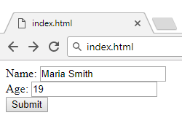
URL Encoded Form Data – Example
<form method="post">
Name: <input type="text" name="name"/> <br/>
Age: <input type="text" name="age"/> <br/>
<input type="submit" />
</form>
File upload fields are not supported (unless multipart encoding is set)
POST /index.html HTTP/1.1
Host: localhost
Content-Type: application/x-www-form-urlencoded
Content-Length: 23
name=Maria+Smith&age=19
URL-encoded form data
Example: https://repl.it/@nakov/http-post-example-name-age

Slide 17
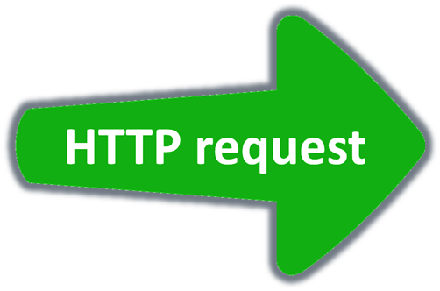
HTTP Request
Request Method, Headers, Body

Slide 18







HTTP Request Methods
HTTP defines methods to indicate the desired action to be performed on the identified resource
CRUD == the four main functions of persistent storage
Method
CONNECT
OPTIONS
TRACE
Method | Description
GET | Retrieve a resource
POST | Create / store a resource
PUT | Update (replace) a resource
DELETE | Delete (remove) a resource
PATCH | Update resource partially (modify)
HEAD | Retrieve the resource's headers
Notes:
The GET method retrieves a specified resource. It is used to download a Web page, CSS file, script, document or other resource from a Web site.
The POST method is used to create (or store) a resource at the Web server.
PUT is used to update (or replace) an existing resource. The HTTP PUT method is used in some applications to replace an existing resource with a new version of this resource.
For example, HTTP PUT can be used to change the shipping address in an e-commerce application.
DELETE is used to delete (or remove) an existing resource.
An example of HTTP DELETE request is for deleting an item from the shopping cart in an e-commerce Web application.
The PATCH method updates an existing resource partially. It is used to modify a field of given object.
An example of HTTP PATCH request is for updating the quantity of an order item in the shopping cart in an e-commerce Web application.
The HTTP HEAD method retrieves the resource's headers, without the resource itself.
HEAD is used rarely, for example to check for modifications at the server side.
The four most important operations for most applications are GET, POST, PUT and DELETE, the so-called "CRUD operations".
HTTP support a few more methods, which are used rarely, in special situations:
CONNECT is used to open a two-way socket connection to the remote Web server. A socket connection can overcome the limitations of the HTTP protocol and its request-response model through lower-level communication.
The OPTIONS method is used to describe the communication options for specified resource. For example, in some situations, the Web client asks the Web server using an HTTP OPTIONS request if it is allowed from a security perspective to request a certain resource. This is called a "cross-origin request" or "CORS".
The HTTP TRACE method is designed for diagnostic purposes during the development and is used very rarely.

Slide 19
HTTP GET Request – Example
GET /users/SoftUni-Tech-Module/repos HTTP/1.1
Host: api.github.com
Accept: */*
Accept-Language: en
Accept-Encoding: gzip, deflate
User-Agent: Mozilla/5.0 (Windows NT 10.0; WOW64) AppleWebKit/537.36 (KHTML, like Gecko) Chrome/54.0.2840.71 Safari/537.36
Connection: keep-alive
Cache-Control: no-cache
<CRLF>
Realtive URI, not full URL
HTTP request line
HTTP headers
The request body is empty
Notes:
The request starts with the "HTTP request line". This is the command we send to the server. This line says what resource we want to get or process.
The request line starts with the request method (in our example "GET"),
followed by the request-URI (this is the resource path, relative to the server's root),
followed by the HTTP version string (for example "HTTP/1.1"),
followed by a new line (CR + LF).
In most computer systems the new line consists of two characters: CR (carriage return, the ASCII code 13) and LF (line feed, the ASCII code 10). This is the new line format used in the HTTP protocol.
Web browsers use URLs, but HTTP uses URIs to address the resources. What's the difference?
URL stands for "uniform resource locator" and it describes a full unique address for a resource in Internet, which consists of protocol + host + resource path, for example: https://softuni.org/about. The URL is what we type in the browser's location bar.
URI stands for "uniform resource identifier" and it holds a full or relative unique path to a resource, for example "/about".
When we request a resource over HTTP, we specify the relative URI of the resource in the request line and we specify the host name in the request headers. Both relative URI and host name come from the URL we want to access.
After the request headers, the request body comes. The request body can also be empty, which is typical for the HTTP GET requests.

Slide 20
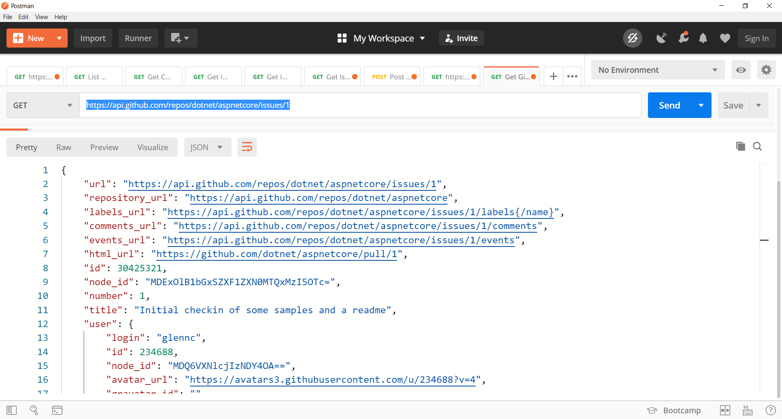
HTTP GET – Example with Postman

Slide 21
HTTP POST Request – Example
URL: https://postman-echo.com/post
POST /post HTTP/1.1
Host: postman-echo.com Accept: */*
Accept-Encoding: gzip, deflate
Content-Type: application/json
Connection: keep-alive Content-Length: 95
<CRLF>
{"title":"Found a bug",
"body":"I'm having a problem with this.",
"labels":["bug","minor"]}
<CRLF>
HTTP request line
HTTP headers
The request body holds the submitted data

Slide 22
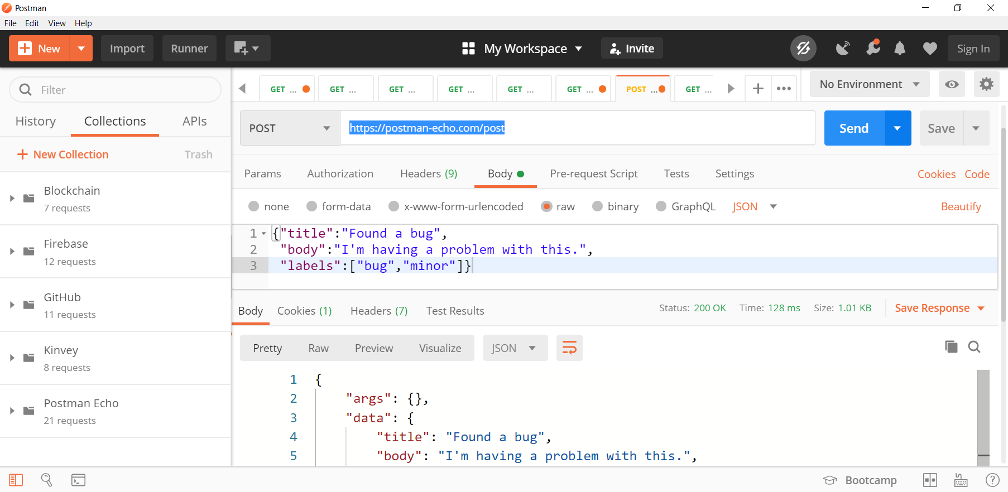
HTTP POST – Example with Postman

Slide 23
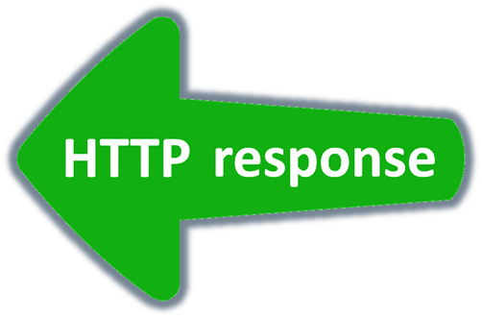
HTTP Response
Response Status, Headers, Body

Slide 24
HTTP Response – Example
HTTP response status line
HTTP/1.1 200 OK
Date: Fri, 11 Nov 2016 16:09:18 GMT+2
Server: Apache/2.2.14 (Linux)
Accept-Ranges: bytes
Content-Length: 84
Content-Type: text/html
<CRLF>
<html>
<head><title>Test</title></head>
<body>Test HTML page.</body>
</html>
HTTP response headers
HTTP response body
Notes:
The HTTP response status line starts with the protocol version, followed by the response status code, followed by a human-readable text explanation of the status code.
The status code tells the client whether the requested operation was successful or not. It may report success (with status code 200) or error (with status code 400 or 500).
Response headers provide metadata about the returned resource (or the returned error), such as content encoding, content size in bytes, content last-modify date and many others.

Slide 25
HTTP Response Status Codes
Status Code | Action | Description
200 | OK | Successfully retrieved resource
201 | Created | A new resource was created
204 | No Content | Request has nothing to return
301 / 302 | Moved | Moved to another location (redirect)
400 | Bad Request | Invalid request / syntax error
401 / 403 | Unauthorized | Authentication failed / Access denied
404 | Not Found | Invalid resource was requested
409 | Conflict | Conflict was detected, e.g. duplicated email
500 / 503 | Server Error | Internal server error / Service unavailable

Slide 26
Content-Type and Disposition
The Content-Type / Content-Disposition headers specify how to process the HTTP request / response body
Standard media types: https://iana.org/assignments/media-types
JSON-encoded data
Content-Type: application/json
UTF-8 encoded HTML page
Content-Type: text/html; charset=utf-8
Content-Type: application/pdf
Content-Disposition: attachment; filename="Financial-Report-2020.pdf"
Download a PDF file

Slide 27
HTTP Conversation: Example
GET /trainings/courses HTTP/1.1
Host: softuni.org
User-Agent: Mozilla/5.0
<CRLF>
HTTP Request
HTTP/1.1 200 OK
Date: Tue, 16 May 2020 15:13:41 GMT
Server: Microsoft-HTTPAPI/2.0
Last-Modified: Tue, 16 Jan 2018 15:13:42 GMT
Content-Length: 18586
<CRLF>
<html><title>Get a Tech Degree from…
</title>
HTTP Response

Slide 28

URL
Protocol, Host, Path, Query String

Slide 29
Uniform Resource Locator (URL)
http://mysite.com:8080/demo/index.php?id=27&lang=en#lectures
Protocol
Host
Port
Path
Query string
Fragment
Network protocol (http, ftp, https...) – HTTP in most cases
Host or IP address (softuni.org, gmail.com, 127.0.0.1, web)
Port (the default port is 80) – integer in the range [0…65535]
Path (/forum, /path/index.php)
Query string (?id=27&lang=en)
Fragment (#slides) – navigate to some section in the page

Slide 30
Query String
Query string contains data that is not part of the path structure
Commonly used in searches and dynamic pages
It is the part of the URL after the question mark (?) symbol
Parameters have name=value format
Multiple parameters are separated by the & delimiter
http://example.com/path/to/page?name=tom&color=purple

Slide 31
URL Encoding
URLs are encoded according to RFC 1738
Normal URL characters – have no special meaning
Reserved URL characters – have a special meaning
Reserved characters are escaped by percent encoding
Space is encoded as "+" or "%20"
[0-9a-zA-Z]
! * ' ( ) ; : @ & = + $ / , ? # [ ]
%[character hex code]

Slide 32
URL Encoding – Examples
All other characters are escaped by % hex code, e.g.
Example:
Char | URL Encoding
space | %20
" | %22
# | %23
$ | %24
Char | URL Encoding
% | %25
& | %26
щ | %D1%89
爱 | %E7%88%B1
Each char is converted to its UTF-8 bytes, represented as hex digits
Наков-爱-SoftUni
%D0%9D%D0%B0%D0%BA%D0%BE%D0%B2-%E7%88%B1-SoftUni

Slide 33
Valid and Invalid URLs – Examples
Some valid URLs
Some invalid URLs
http://www.google.bg/search?sourceid=navclient&ie=UTF-8&rlz=1T4GGLL_enBG369BG369&q=http+get+vs+post
http://bg.wikipedia.org/wiki/%D0%A1%D0%BE%D1%84%D1%82%D1%83%D0%B5%D1%80%D0%BD%D0%B0_%D0%B0%D0%BA%D0%B0%D0%B4%D0%B5%D0%BC%D0%B8%D1%8F
Should be: C%23+.NET+4.0
http://google.com/search?&q=C# .NET 4.0
http://google.com/search?&q=код
Should be: %D0%BA%D0%BE%D0%B4

Slide 34

Summary
…
…
…
HyperText Transfer Protocol
Text-based client-server protocol for the Internet
Works with message pairs
Request: method + headers + body
Response: status + headers + body
The URL parts: protocol, host, port, path, query string and fragment

Slide 35
Questions?
Notes:
35

Slide 36
Trainings @ Software University (SoftUni)
Software University – High-Quality Education, Profession and Job for Software Developers
softuni.bg, softuni.org
Software University Foundation
softuni.foundation
Software University @ Facebook
facebook.com/SoftwareUniversity
Software University Forums
forum.softuni.bg
36
Notes:
36

Slide 37

License
This course (slides, examples, demos, exercises, homework, documents, videos and other assets) is copyrighted content
Unauthorized copy, reproduction or use is illegal
© SoftUni – https://softuni.org
© Software University – https://softuni.bg
Notes:
37

